Slide 1

Break your eating habits
The smart solution to over-pollution

Slide 2
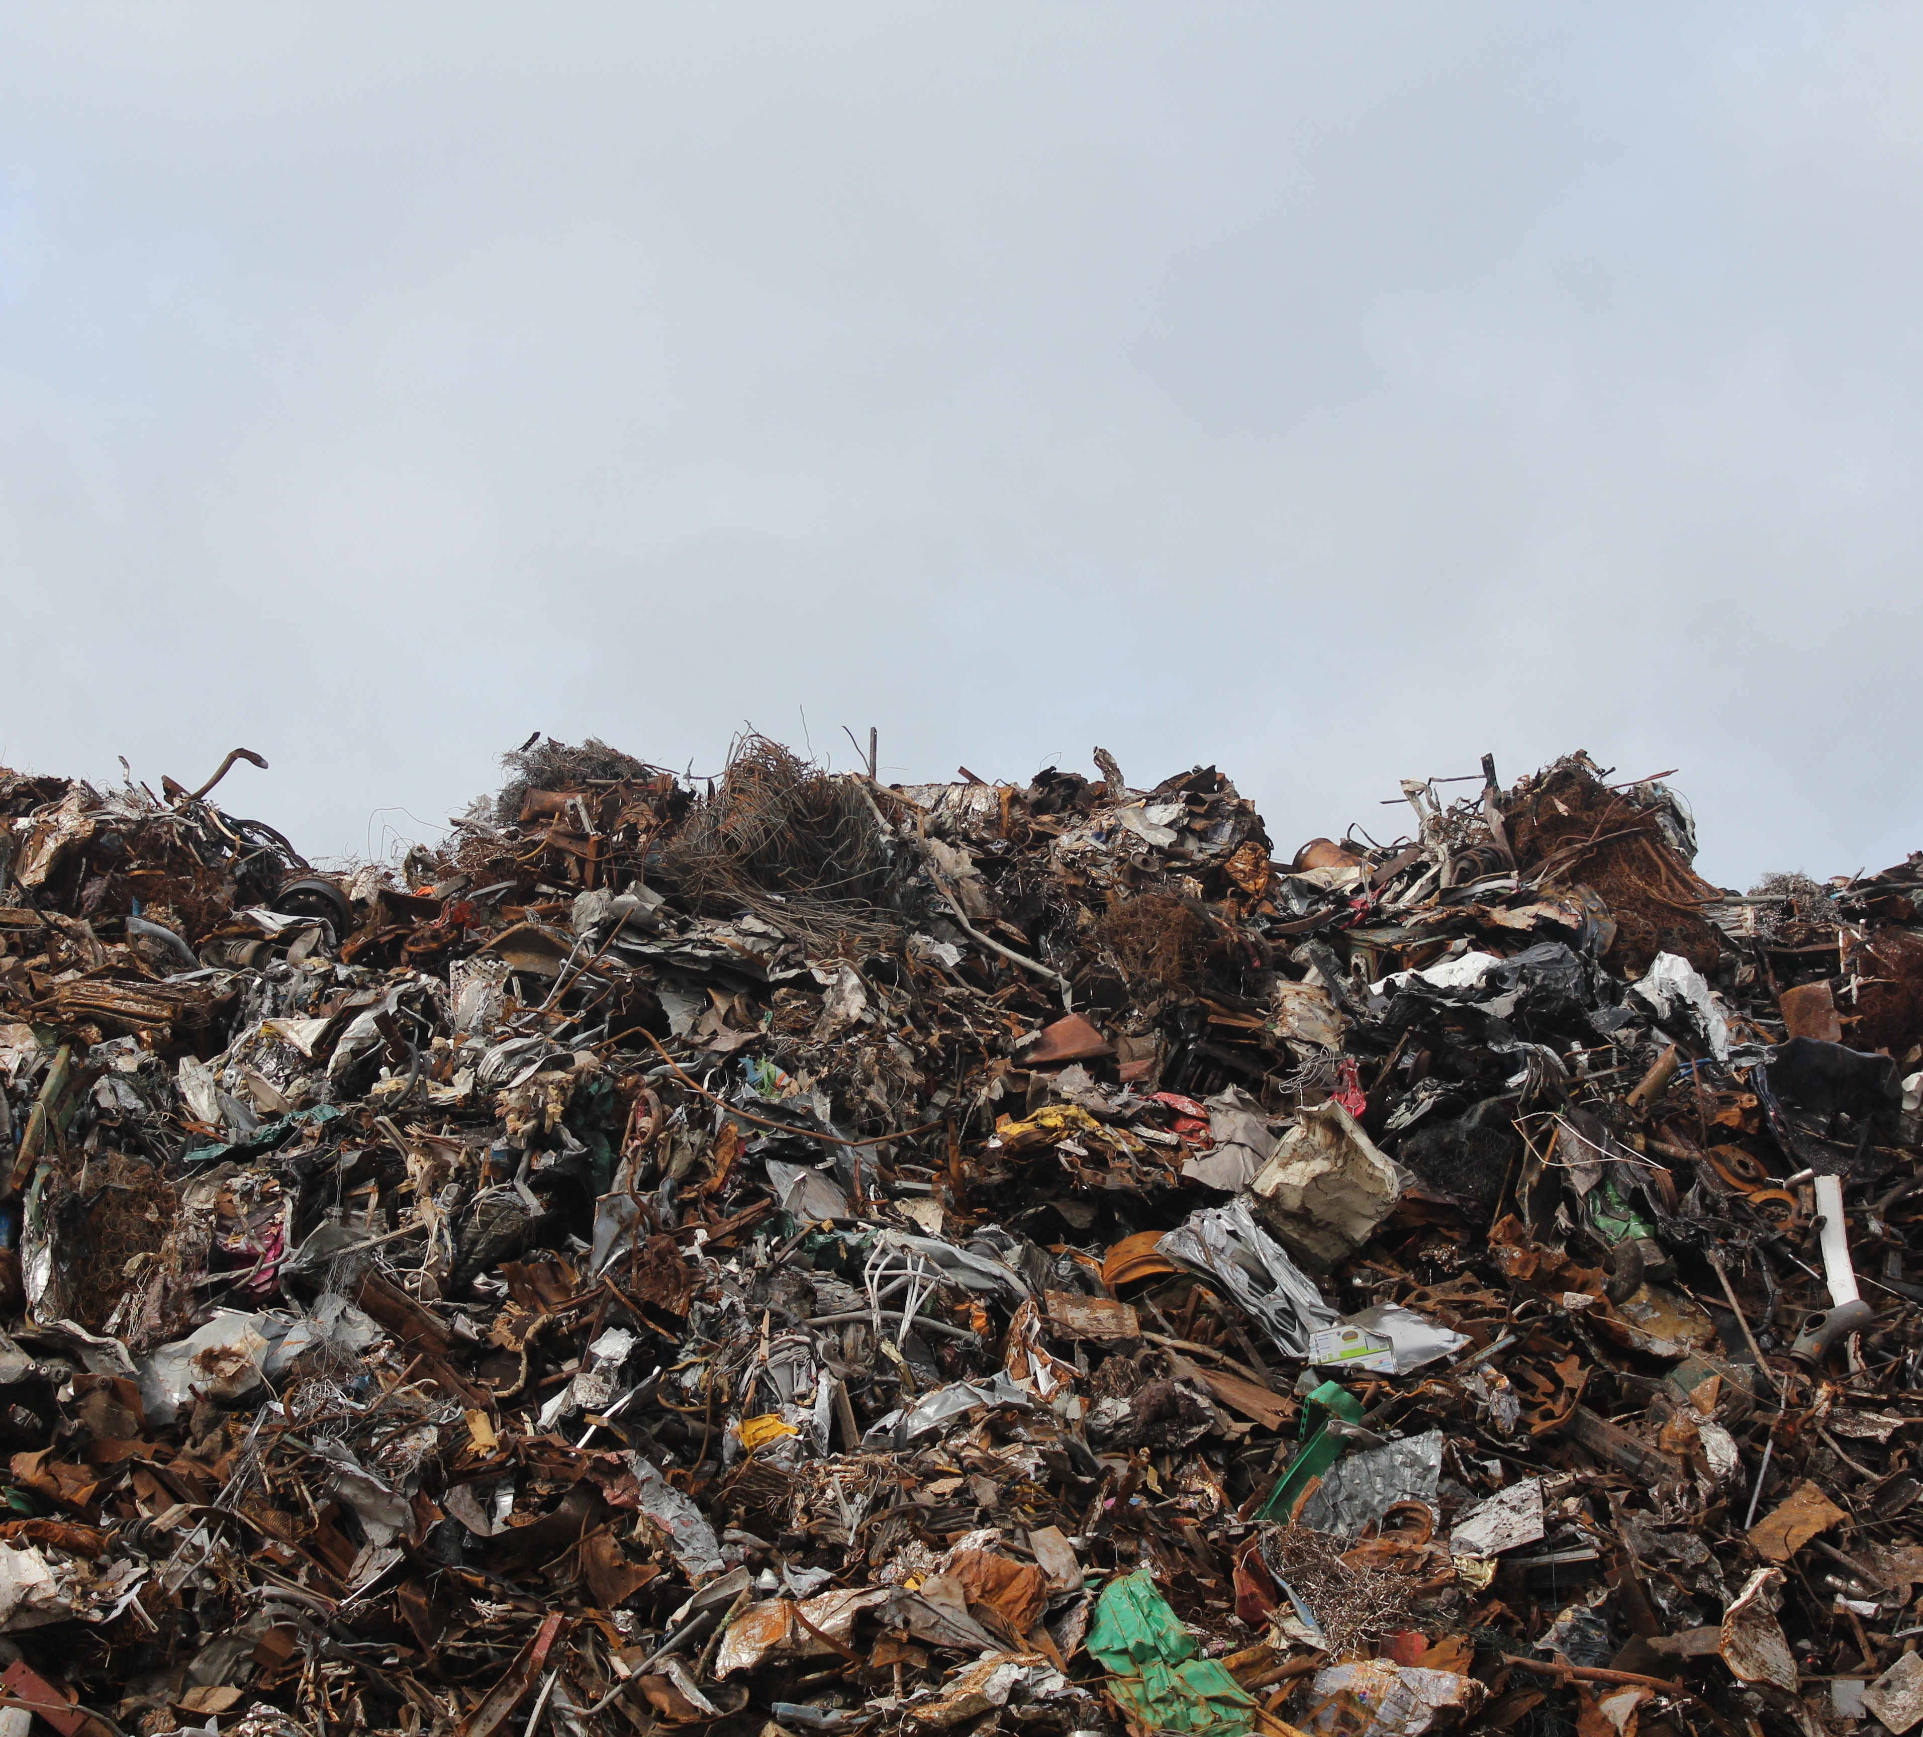
The problem: Huge resource waste
The population is growing
Our resources are limited

Slide 3

The solution: Raise awareness
What environmental impact does this have?
People want to do good
Give them the opportunity

Slide 4
How can we achieve this?
People are inherently lazy
Nobody wants to constantly check their environmental impact

Slide 5
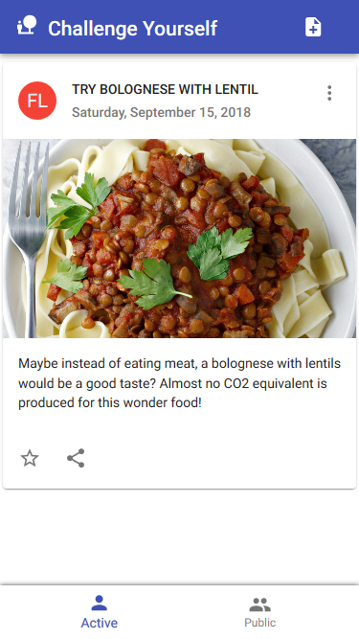
Introducing… BYEh! Break your eating habits
Challenge your friends to reduce their environmental impact
They can forward the challenge or create a new one

Slide 6
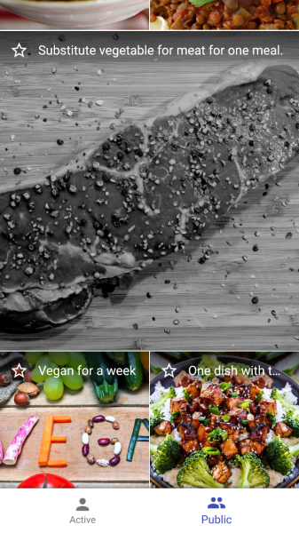
Introducing… BYEh! Break your eating habits
Check out popular challenges that others are doing currently

Slide 7
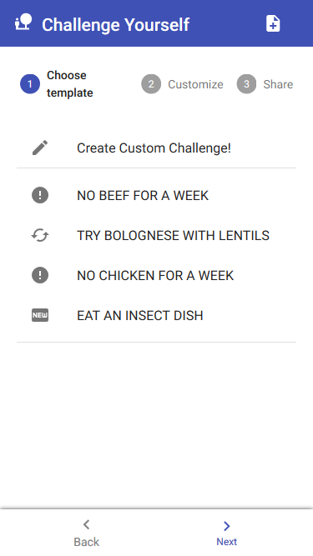
Introducing… BYEh! Break your eating habits
Create a challenge for your friends from a template or completely custom

Slide 8
Education is the most powerful weapon which you can use to change the world.
– Nelson Mandela
So let’s change it… together!

